Slide 1
TWITTER TOPIC DYNAMICS AND SENTIMENT VARIATIONS OF COVID - 19
ARUNKUMAR.D (723718104009)
SARAN.K (723718104045)
SARUKKHAN.N (723718104048)
GUIDED BY:- Mr. P.DINESH KUMAR H.o.D CSE.,

Slide 2
ABSTRACT
The advent of Covid-19 has tremendously affected the global economy. More people have suffered, and some of them even lost their lives. As the worst part, many countries are seeing fourth wave of Covid-19 cases despite the vaccination. India is one such country that is worse affected by the Covid-19. Understanding what people of India think and how they express their thoughts through social media platforms like Twitter has a vast significance.
Therefore, in this project, we aim to use Covid-19 related tweets during the first Covid-19 lockdown in India and after introduction of vaccines, and apply the Nonnegative Matrix Factorization (NMF) algorithm to elicit topic dynamics. While knowing the sentiments of people is important, identifying sentiments for each tweet is time-consuming and hard to interpret. Therefore, in this project, we propose to apply sentiment analysis on the topics identified using NMF.

Slide 3
EXISTING SYSTEM
There are various researches on Sentimental analysis on Covid-19 made across the globe with elicitation of public emotions.
However, those are concentrated either only on data during lockdown or data after vaccination and most of researches are not from India

Slide 4
PROPOSED SYSTEM
In our work, we focus on data from both during lockdown and after introduction of vaccines. We elicit the topics that are in the form of tweets tweeted by people of India about Covid-19 across the country and variation of sentiments/emotions as a result of the analysis. This will help us to understand people’s mindset during these two phases.

Slide 5
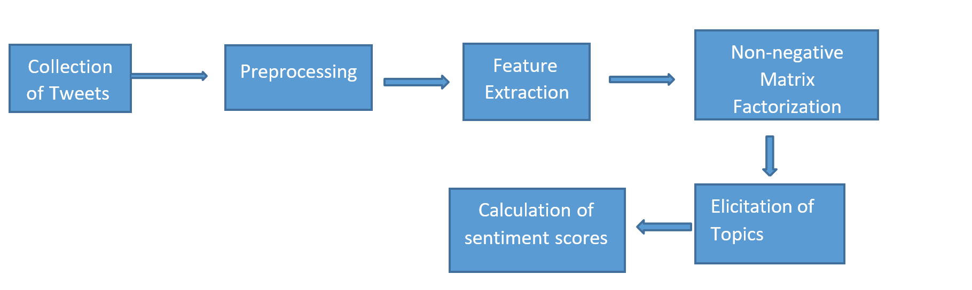
BLOCK DIAGRAM

Slide 6
TERM FREQUENCY-INVERSE DOCUMENT FREQUENCY
Here we use TF-IDF (Term Frequency-Inverse Document Frequency) technique for text feature extraction. It is one of the most important techniques used for information retrieval to represent how important a specific word or phrase is to a given document.
TF-IDF use two statistical methods, first is Term Frequency and the other is Inverse Document Frequency. Term frequency refers to the total number of times a given term t appears in the document doc against (per) the total number of all words in the document and The inverse document frequency measure of how much information the word provides. It measures the weight of a given word in the entire document. IDF show how common or rare a given word is across all documents.

Slide 7
NON-NEGATIVE MATRIX FACTORIZATION
Non-negative matrix factorization (NMF or NNMf), also non-negative matrix approximation is a group of algorithms in multivariate analysis and linear algebra where a matrix V is factorized into two matrices W and H, with the property that all three matrices have no negative elements.
The objective of NMF is dimensionality reduction and feature extraction. So, when we set lower dimension as k, the goal of NMF is to find two matrices W∈ Rm×k and H ∈ Rn×k having only nonnegative elements. Therefore, by using NMF we are able to obtain factorized matrices having significantly lower dimensions than those of the product matrix.

Slide 8
TEXTBLOB
Here, we used TextBlob to extract sentiments for each topics. TextBlob is a Python library for processing textual data. It provides a simple API for diving into common natural language processing (NLP) tasks such as part-of-speech tagging, noun phrase extraction, sentiment analysis, classification, translation, and more. The approach that the TextBlob package applies to sentiment analysis differs in that it’s rule-based and therefore requires a pre-defined set of categorized words.

Slide 9
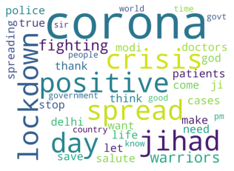
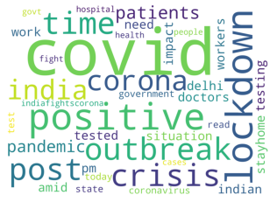
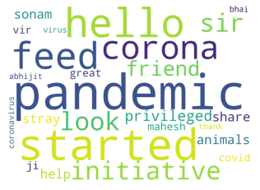
RESULTS
TOPIC 1
TOPIC 2
TOPIC 3
Spread of corona and lockdown imposed by government to fight against the spreading disease.
Sentiment SCORES=0.3761363636363636
Outbreak of Covid-19 across the country and reports on testing and positive cases.
Sentiment SCORES=0.22727272727272727
People started an initiative to help animals during pandemic by feeding them.
Sentiment SCORES=0.8

Slide 10
SENTIMENT SCORES
1st LOCKDOWN | AFTER VACCINATION
0.3761363636363636 | 0.36818181818181817
0.22727272727272727 | 0.46666666666666673
0.8 | 0.4333333333333333
0.08556149732620322 | 0.37857142857142856
0.13333333333333336 | 0.10952380952380954
0.4666666666666667 | 0.21666666666666667
-0.3333333333333333 | -0.1111111111111111
0.3583333333333334 | 0.22227272727272726
0.0 | 0.014285714285714287
0.17171717171717166 | 0.0

Slide 11
CONCULSION
The Covid-19 pandemic has changed everyone's life in some way or another. While we started to fight Covid-19, understanding more about what impact it has created in the people is important to effectively deal with it. In this work, we propose to apply the NMF algorithm to learn the topic dynamics of Covid- 19 during the first lockdown and after vaccination in India.
We also apply sentiment analysis on the topics to better understand the variations in sentiments of people. This research demonstrates the usage of advanced machine learning algorithms to leverage huge text data generated in social media for the betterment of people

Slide 12
FUTURE WORK
The model we used in this research is quite good in elicitation of topics, however, we plan to apply more advanced techniques like Non-negative Tensor Factorization (NTF) to extract topics with more accuracy. And we further extend our research to learn spatio-temporal dynamics for a better

Slide 13
REFERENCE
AlAgha, I.: Topic modeling and sentiment analysis of twitter discussions on covid19 from spatial and temporal perspectives. Journal of Information Science Theory and Practice 9(1), 35–53 (2021).
Balasubramaniam, T., Nayak, R., Bashar, M.A.: Understanding the spatiotemporal topic dynamics of covid-19 using nonnegative tensor factorization: a case study. In: 2020 IEEE Symposium Series on Computational Intelligence (SSCI). Pp.1218–1225. IEEE (2020).
Balasubramaniam, T., Nayak, R., Luong, K., Bashar, M.A.: Identifying covid19 misinformation tweets and learning their spatio-temporal topic dynamics using nonnegative coupled matrix tensor factorization. Social Network Analysis and Mining 11(1), 1–19 (2021).
Balasubramaniam, T., Nayak, R., Yuen, C.: Efficient nonnegative tensor factorization via saturating coordinate descent. ACM Transactions on Knowledge Discoveryfrom Data (TKDD) 14(4), 1–28 (2020).
Barkur, G., Vibha, G.B.K.: Sentiment analysis of nationwide lockdown due to covid-19 outbreak: Evidence from india. Asian journal of Psychiatry 51, 102089 (2020).
Dubey, A.D.: Twitter sentiment analysis during covid-19 outbreak. Available at SSRN 3572023 (2020).
Kaur, C., Sharma, A.: Twitter sentiment analysis on coronavirus using textblob.Tech. Rep., EasyChair (2020).

